Slide 1
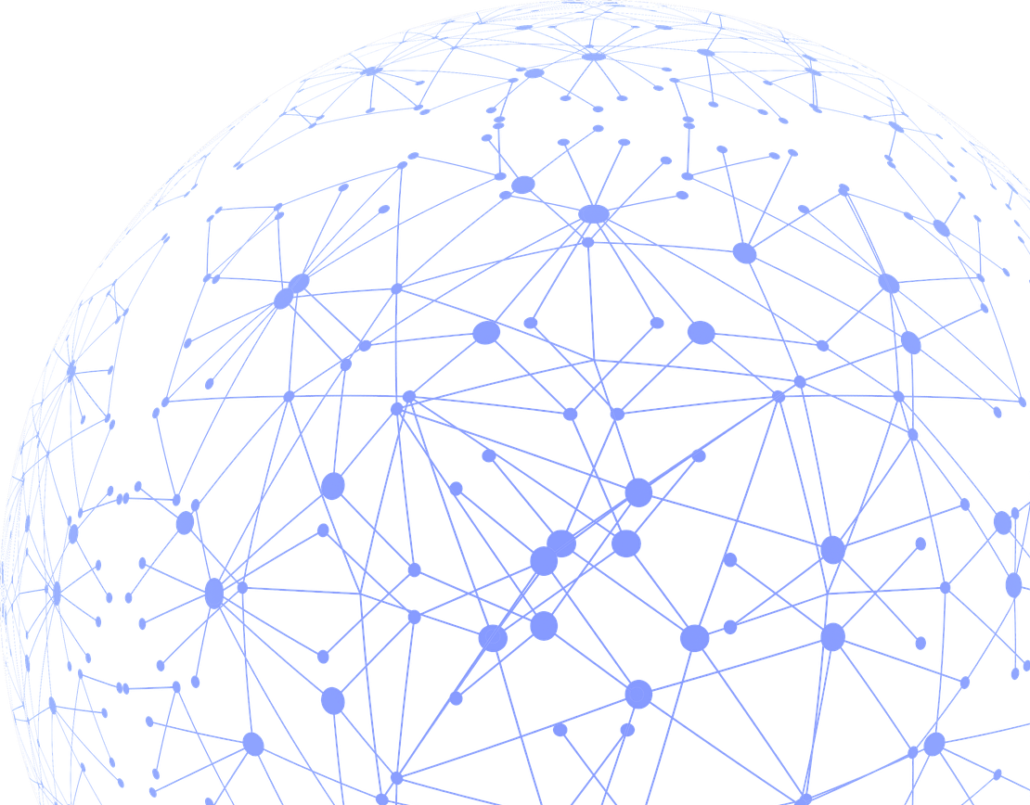
Graph Databases and Graph Visualizations
Ben Doan
March 24, 2021

Slide 2






About Me
Data Scientist and Full Stack Developer at Greenzone (Ambit Group)
Working with distributed computing infrastructure for big data analytics and graph databases
Projects include anti-human trafficking and child exploitation counter-intelligence
That’s Me!
McIntire Class of 2017, Block 2
Email: kdoan@greenzoneinc.com || knd9uz@virginia.edu

Slide 3
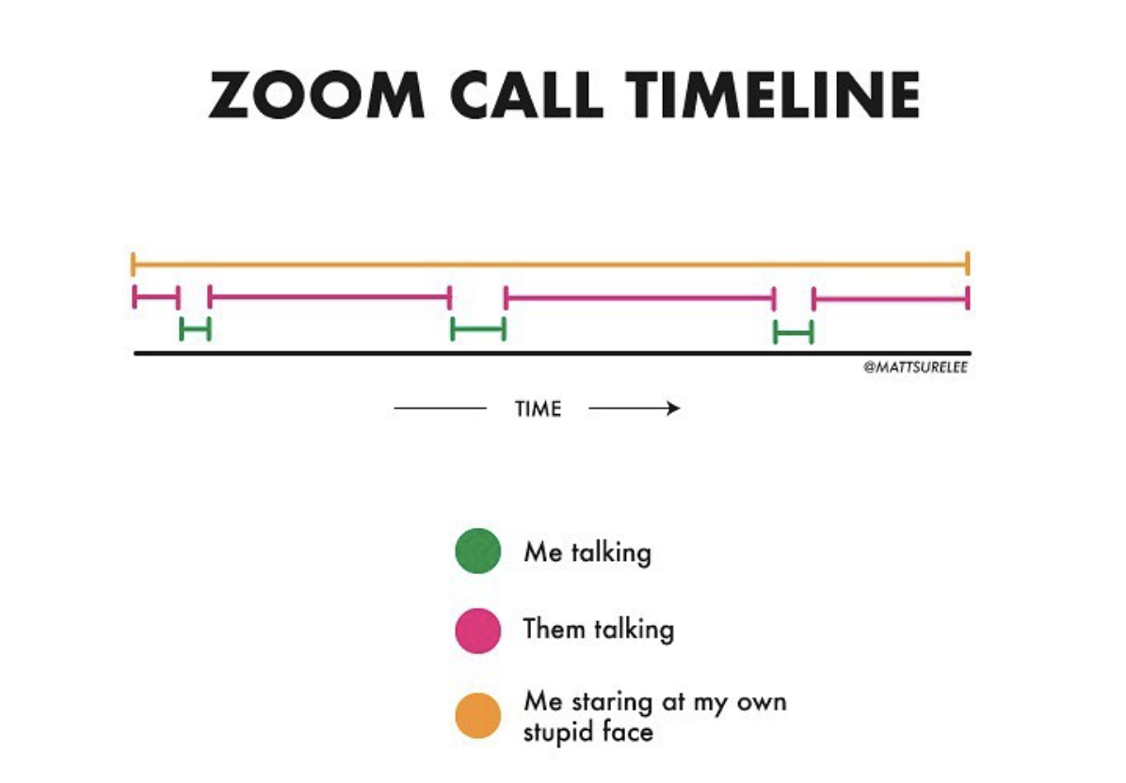
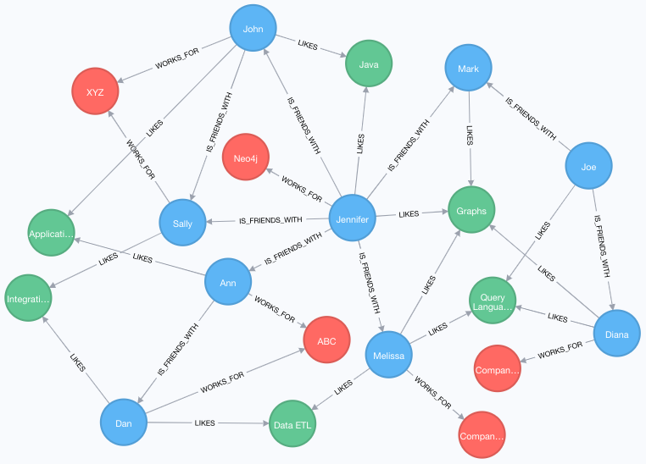
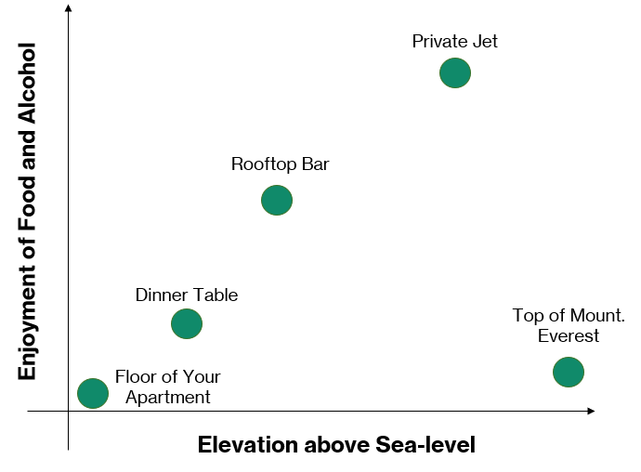
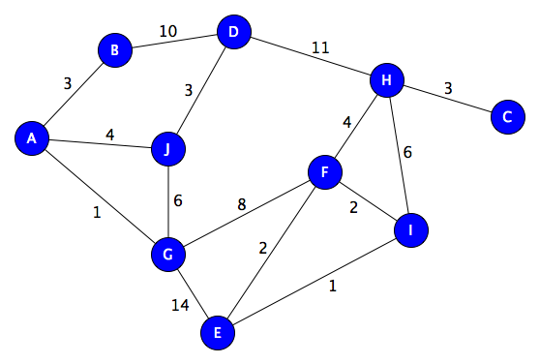
What are Graphs?
The term “graph” can refer to one of two things
Pictorial representation or a diagram that represents data or values in an organized manner.
Mathematical structures made up of vertices (nodes or points) which are connected by edges (links or edges).
Rooftop Bar
Source: @mattsurelee
Balcony at Trinity
Source: my brain
Source: Neo4j

Slide 4
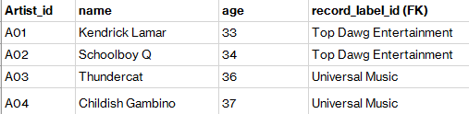
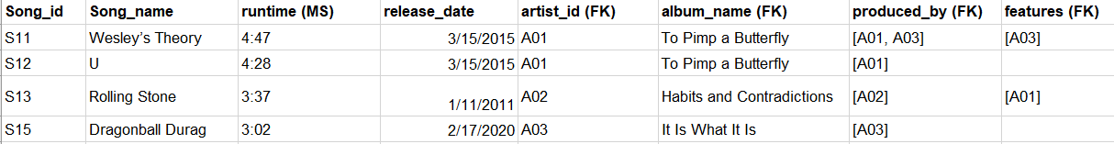
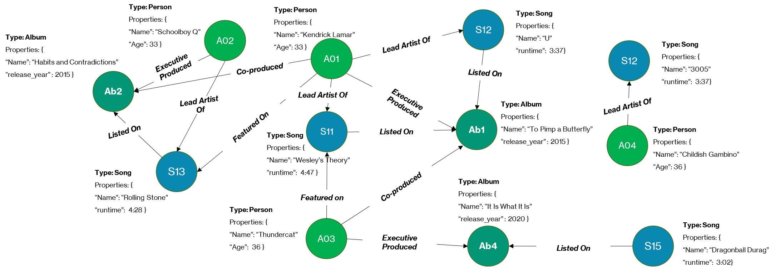
What are Graph Databases?
A graph database is a database that uses a vertex and edge structure for data representation and querying, instead of the traditional row and column format. This is done by converting the rows in a table to vertexes and certain key columns to edges
S14

Slide 5
Why Use a Graph?
Traditional relational database structures (RDBs) or RDB-like structures are generally rigid, which is good for strict control over entities and attributes, but bad for modeling links or relationships
In RDBs, entities or “things” are represented as rows in tables
Characteristics of “things” are columns represented as columns
Types of “things” are captured in the name of the table
RDB ER Diagram: Music Labels & Artists
Entities and Things
Song table
Song_id | Song_name | artist_id | runtime | album_id
S11 | Wesley’s Theory | A01 | 4:47 | Ab1
S12 | U | A01 | 4:28 | Ab1
S13 | Rolling Stone | A02 | 3:37 | Ab2
S14 | 3005 | A04 | 3:54 | Ab3
S15 | Dragonball Durag | A03 | 3:02 | Ab4
Relationships between entities or “things” are represented by foreign keys
This makes RDBs more rigid when it comes to modeling the links or relationships between things, and it makes visualizing the relationships between entities more difficult
Relationships between Entities
Album Table
id | name | release_year | artist_id
Ab1 | To Pimp a Butterfly | 2015 | A01
Ab2 | Habits and Contradictions | 2012 | A02
Ab3 | Because the Internet | 2013 | A04
Ab4 | It Is What It Is | 2020 | A03

Slide 6
Why Use a Graph?
Whereas traditional row and column data is good for row/column-wise aggregations, graphs are great when it comes to visualizing and analyzing networks and relationships within and between datasets
IBM Team Collaboration Graph shows the social network analysis of its team’s code commits and comments, to identify key information brokers, isolated teams, and interconnected teams
Source: Jason Plurad, IBM Big Data Meet-Up, 2017

Slide 7
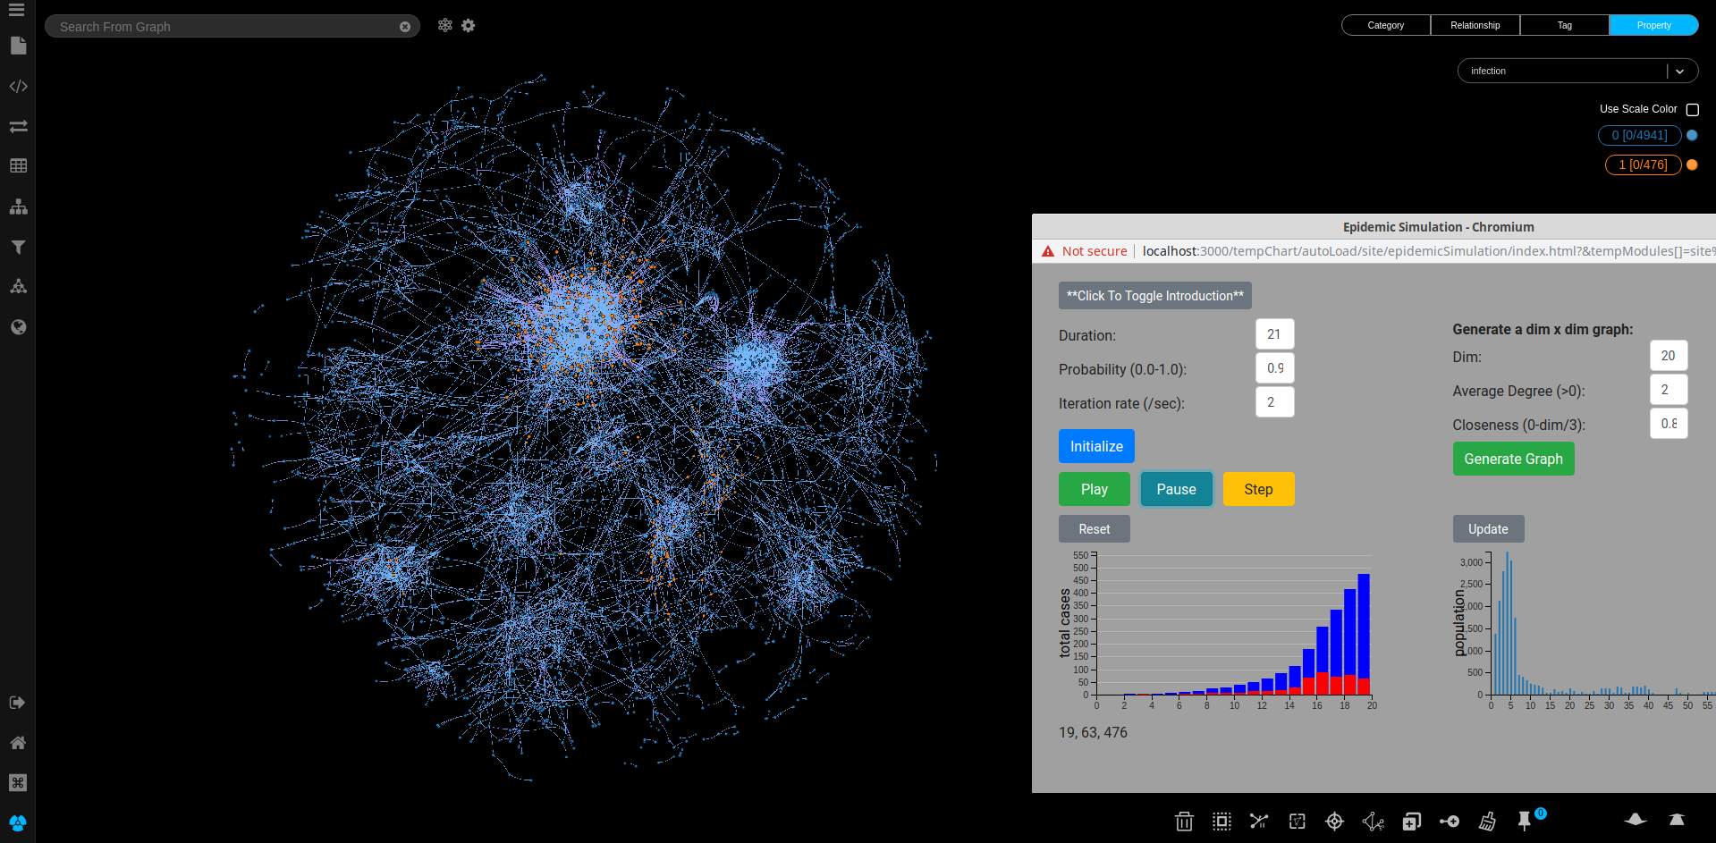
Why Use a Graph?
Whereas traditional row and column data is good for row/column-wise aggregations, graphs are great when it comes to visualizing and analyzing networks and relationships within and between datasets
Covid Epidemic simulator built during the Neo4j Graph4Good competition, which uses graph networks and social media contact points to project the spread of COVID-19 under various conditions
Source: Robert Allison, Weidong Yang, David Hughes and Sachin Deshpande @ Graph4Good GraphHack by Neo4j

Slide 8


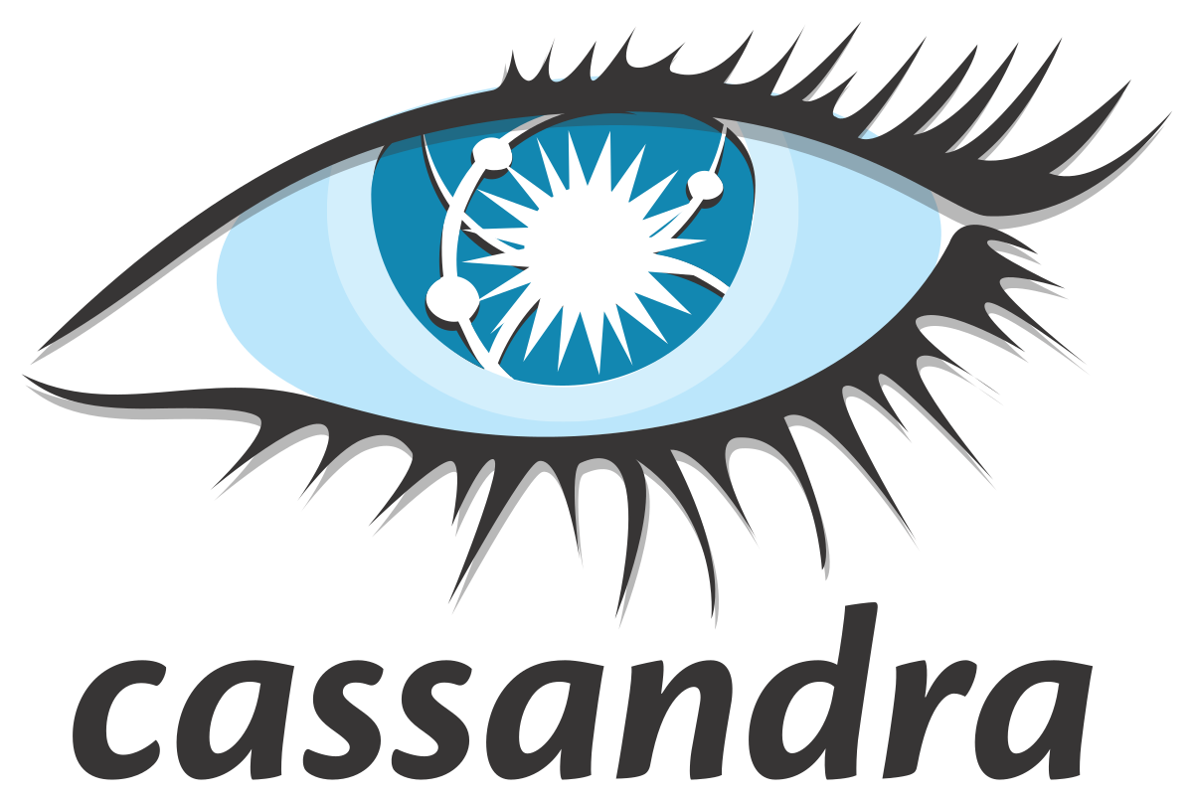



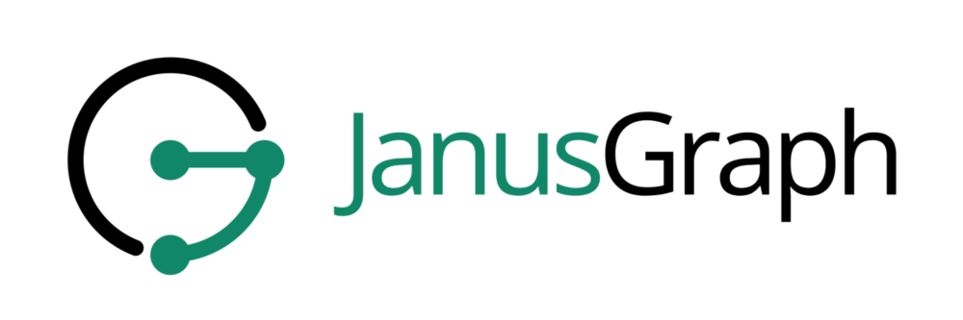
Graph Database Demonstration: Personal Spotify Artist Networks
The following process demonstrates how we convert raw data provided an API service to a graph-based format and visualization
Key Steps
Raw Data
Intermediate Tables
Vertex and Edge Transition
Graph Creation
Visualization
Extract data from source backend (usually a database, sometimes a csv file)
For this example, we will hit the Spotify database, via it’s open source API
Temporarily load the data into a table (with rows and columns) so we can see which columns are foreign keys that need to be transitioned to edges
Convert the rows to vertexes, and the foreign key columns to edges
Load the new vertexes and edge data into a separate graph database backend
Pull the edges and vertexes into a visualization tool
Data Ingest
Data Cleaning and Transformation
Data Loading
Data Visualization
Toolkit

Slide 9
Graph Database Demonstration

Slide 10


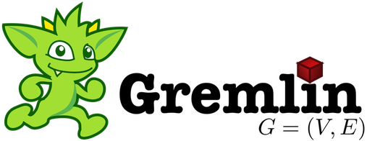




Common Graph Tools
Graph tools are growing across multiple industries and consist of both open-source and managed services
Graph Databases
An industry leading suite of graph tools for graph databases, data cleaning, graph transitions and visualizations
Leading open-source distributed graph database, used for extremely large graphs that need to be stored on a cluster
Graph database service managed by Amazon Web Services (AWS)
Querying Tools
Visualization Tools
Apache Tinkerpop Gremlin provides and intuitive, native-code embedded framework for easily querying graphs (traversals)

Slide 11
Want to Learn More?
Anyone interested in learning more about graph tools can check out the following sources
Prerequisites:
Basic understanding of functional (Python) and object-oriented programming (Java/JavaScript)
Graph Database Documentation
Neo4j: https://neo4j.com/developer/
JanusGraph: https://docs.janusgraph.org/
Apache Tinkerpop (for graph queries): https://tinkerpop.apache.org/
Datasets:
https://snap.stanford.edu/data/ (< Includes a Twitter memetracker graph)
http://networkrepository.com/
https://graphchallenge.mit.edu/data-sets

Slide 12
Questions

Slide 13
Appendix

Slide 14
Type: Person
Properties: {
“Name”: “Schoolboy Q”
“Age”: 33 }
Type: Person
Properties: {
“Name”: “Kendrick Lamar”
“Age”: 33 }
Type: Song
Properties: {
“Name”: “U”
“runtime”: 3:37}
S12
A02
Type: Album
Properties: {
“Name”: “Habits and Contradictions”
“release_year” : 2015 }
Lead Artist Of
Type: Song
Properties: {
“Name”: “3005”
“runtime”: 3:37}
A01
S12
Executive Produced
Co-produced
Ab2
Listed On
Lead Artist Of
Lead Artist Of
Executive Produced
Type: Album
Properties: {
“Name”: “To Pimp a Butterfly”
“release_year” : 2015 }
Lead Artist Of
S11
Ab1
Listed On
Featured On
Listed On
A04
Type: Person
Properties: {
“Name”: “Childish Gambino”
“Age”: 36 }
Type: Song
Properties: {
“Name”: “Wesley’s Theory”
“runtime”: 4:47 }
S13
Type: Song
Properties: {
“Name”: “Rolling Stone”
“runtime”: 4:28 }
Co-produced
Type: Album
Properties: {
“Name”: “It Is What It Is”
“release_year” : 2020 }
Featured on
Type: Person
Properties: {
“Name”: “Thundercat”
“Age”: 36 }
A03
Ab4
S15
Type: Song
Properties: {
“Name”: “Dragonball Durag”
“runtime”: 3:02}
Executive Produced
Listed On

